Slide 1
Final presentation on Cancer research

Slide 2
Goal of the project
Using MIR spectra data label tissue samples in order to research the inner structure of the sample
Hopefully find some patter
what spectra affects the classification negatively?

Slide 3
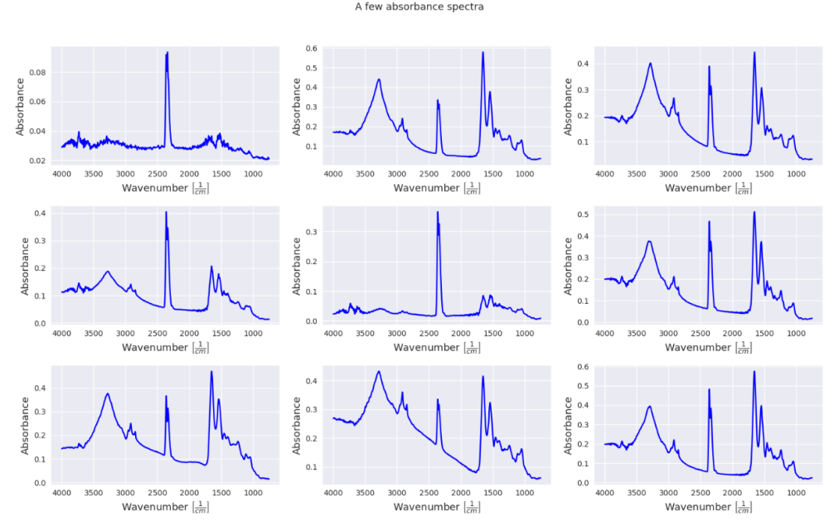
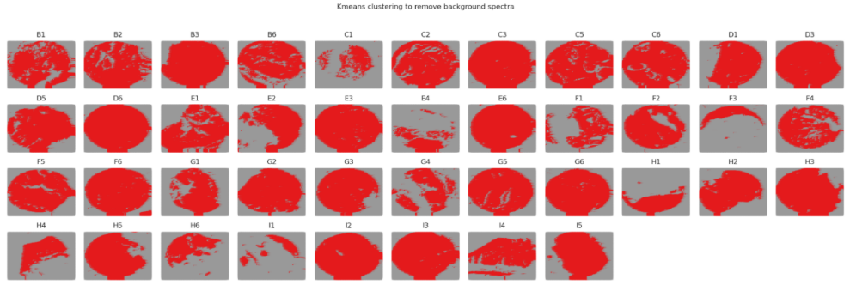
Data handling
I had to transform to absorbance
Used K-means clustering to
differentiate between tissue and
background data points

Slide 4
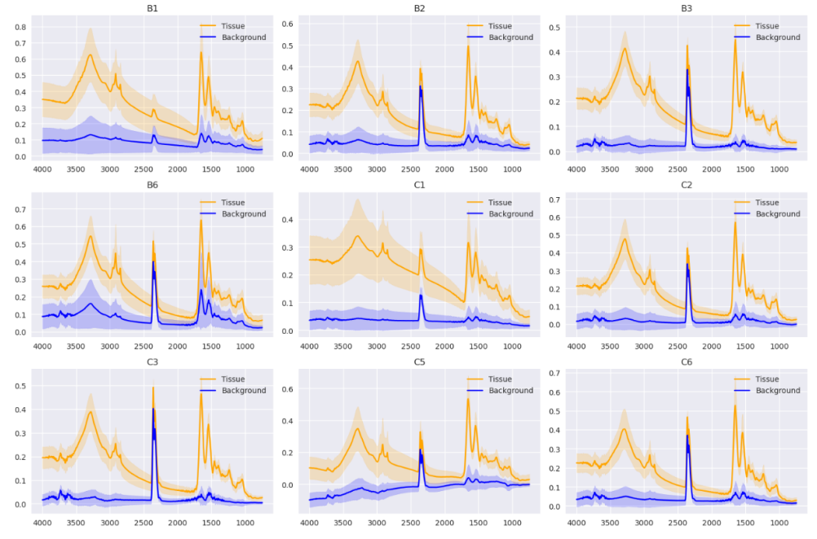
Spectra
With MIR we can identify some spectra from the tissue
Easily recognizable sources:
-at 4000 water vapor
-3500 nitrogen-hydrogen bond
-3000 hydrocarbon
-2250 carbon dioxide
-1500 protein
-1250 carbohydrates

Slide 5
Machine learning
Big data(9TMA(Tissue Micro Array) -> problems with pandas -> XGBoost Dmatrix
 | With CO2 peak | Without CO2 peak
Accuracy | 0.723(0.663,0.783) | 0.757 (0.690,0.824)
AUROC | 0.789(0.721,0.854) | 0.828(0.747,0.898)
Sensitivity | 0.771(0.701,0.837) | 0.801(0.737,0.863)
Specificity | 0.623(0.601,0.709) | 0.695(0.610,0.778)

Slide 6
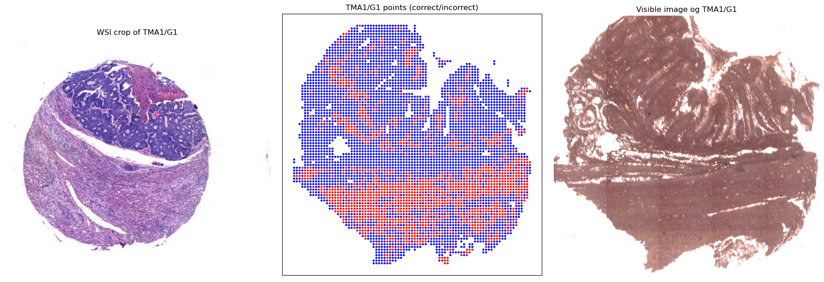
Inner structure
I plotted Whole Slide Images(WSI), scatter plots and visible MIR images to see better the differences
Kinda can be seen which spectra affects classification negativly

Slide 7
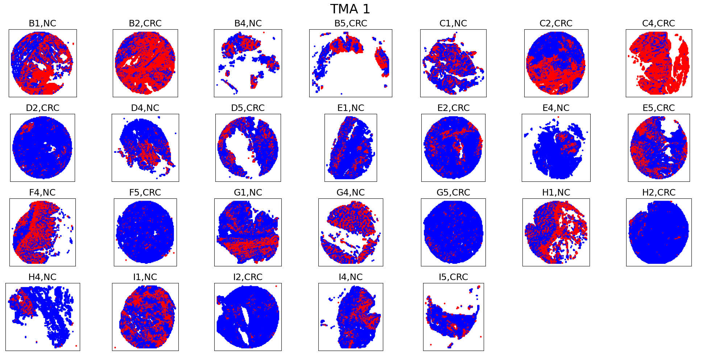
Inner structure

Slide 8
Conclusion
Topic was interesting
There were challenging parts(DMatrix, data streaming)
Great tutolage
Opportunities at being creative

Slide 9
Chatgpt usage
my questions are mainly “make a for cycle from this featuring all TMA with all labels like this…”
Sometimes I have to explain a few times before it understands
I might have registered with another email to have more tokens

Slide 10
If I were to continue
Look into PCA more
Try more statistical analysis

